Slide 2
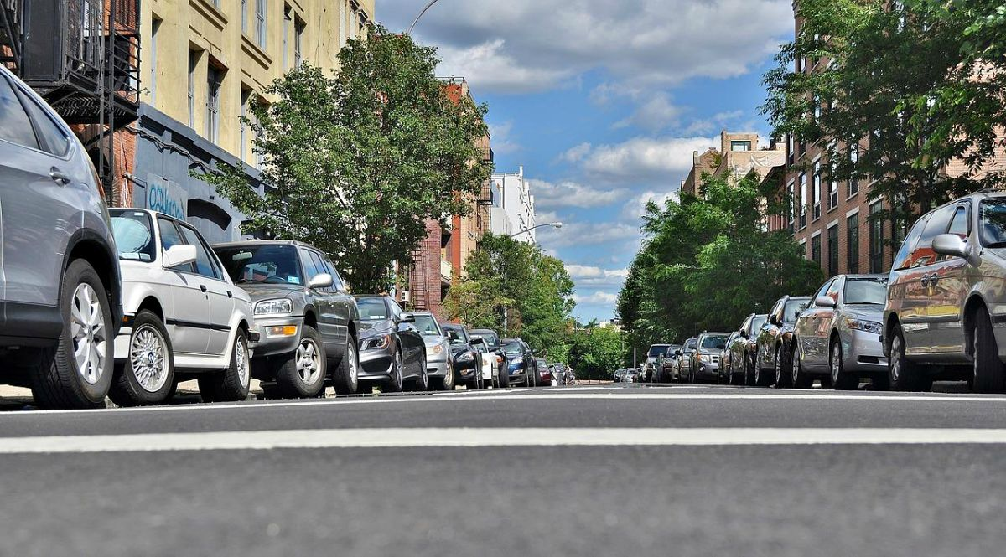
Parkomatic.
park easy, park fast, parkomatic!
Notes:
https://pixabay.com/en/macbook-apple-imac-computer-screen-606763/

Slide 3




The parking problem
Example from Germany
896€ per driver
40 hours
30% of traffic is caused by parking
64% of drivers are stressed while parking

Slide 4
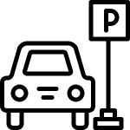



Customer Validation
66% of people hate looking for parking.
100% of people agree that the city hall has to tackle parking problems.
Average fined twice per year (35€).
Parking is worse before and after rush hours.
Notes:
Personal tests in several cities.
Online interviews in places such as reddit.

Slide 5


Our Service Model
Monthly Payment
Collect and analyze data and find vacant spot
Our Company
Customers
Find and suggest vacant parking spot
Provide camera data
･Install cameras
･Provide Free WiFi
Taxi Drivers

Slide 6







Current Solutions
Sensors
Cameras
APIs

Slide 7
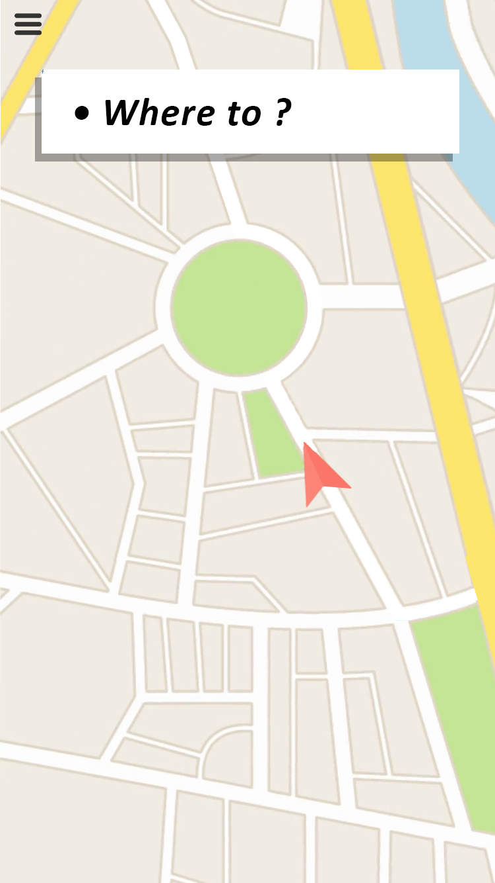
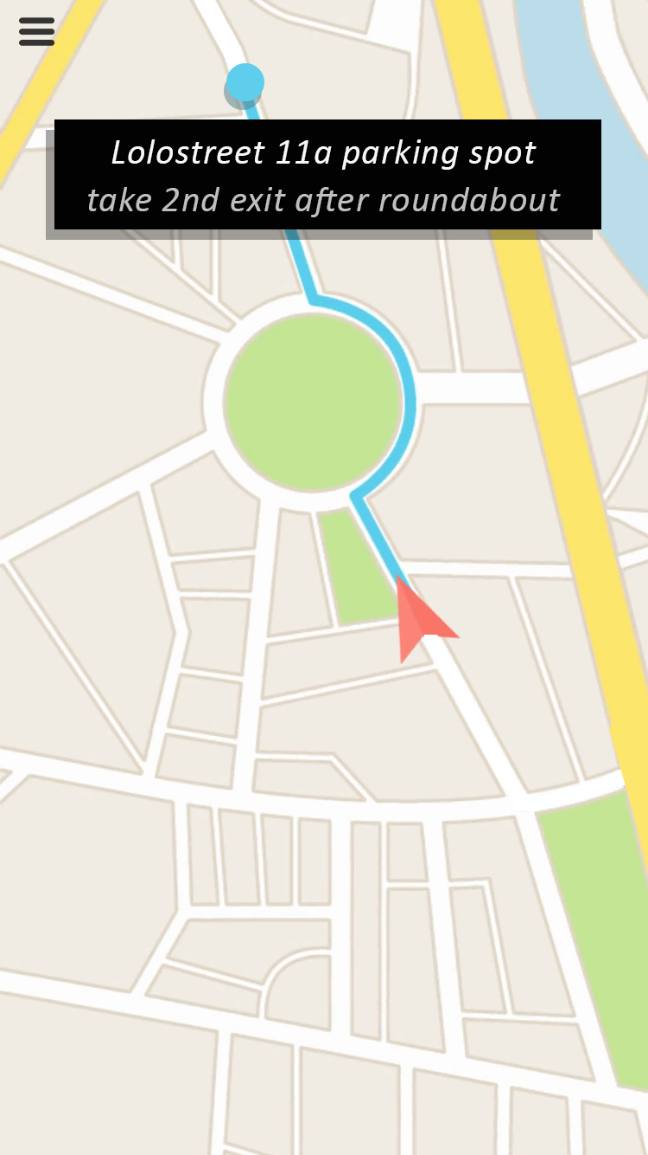
Prototype
Subscription service for the navigation to vacant on-street parking spots.

Slide 8

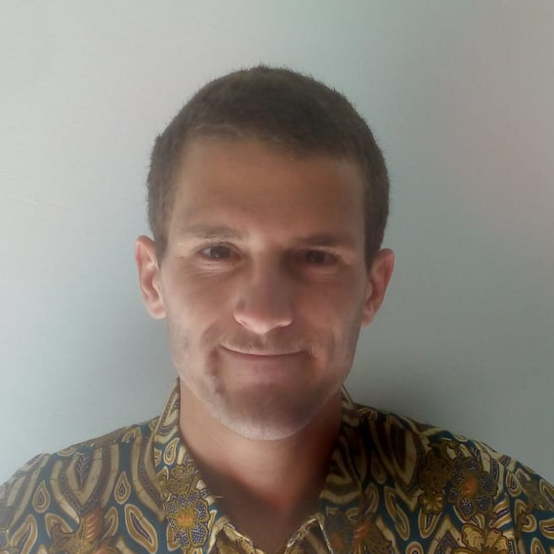


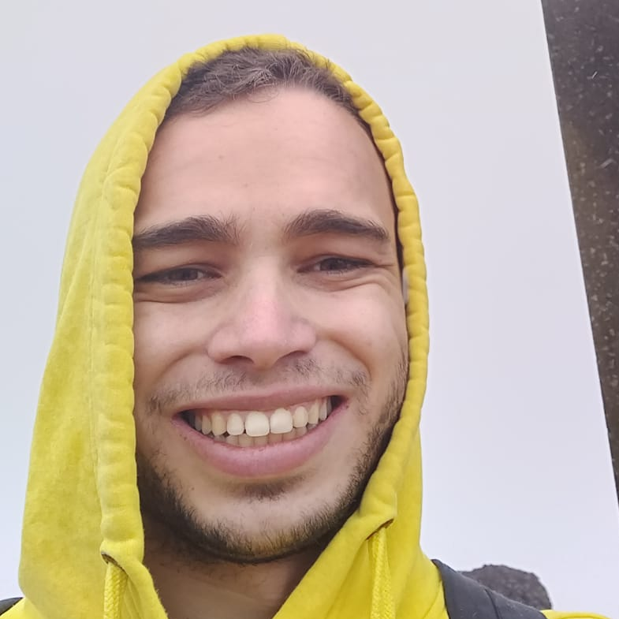
Our team
Adam
Bako
Data Scientist & Developer
Lorenzo
Foà
Data scientist &
Sales
Gereltsetseg
Altangerel
Computer networking & Researcher
Marina
Kurokawa
Marketing &
Financing
Ignacio
Aparicio Vázquez
Data Scientist & Computer vision expert

